Slide 1
Principles of Package Cohesion and Coupling

Slide 2
Objectives
To introduce and understand two principles of package cohesion
  The Common Closure Principle
  The Common Reuse Principle
To introduce and understand three principles of package coupling
  The Acyclic Dependencies Principle
  The Stable Dependencies Principle
  The Stable Abstractions Principle

Slide 3
Principles of Package Cohesion
The Common Closure Principle
The Common Reuse Principle

Slide 4
The Common Closure Principle
Classes that change together, belong together.
The work to manage, test, and release packages is non-trivial.
  The more packages that change in any given release, the greater the work to rebuild, test, and deploy the release.
Therefore we would like to minimize the number of packages that are changed in any given release cycle of the product.
To achieve this, we group together classes that we think will change together.
  This is not easy since we must anticipate the kinds of changes that are likely.

Slide 5
The Common Reuse Principle
Classes that aren’t reused together should not be grouped together.
When a package changes, all clients of that package must verify that they work with the new package -- even if nothing they used within the package actually changed.
If classes that are not used together are grouped together, then changes to a class that we don’t care about will still force a new release of the package, and still cause us to go through the effort of upgrading and revalidating.

Slide 6
Tradeoffs Between
CCP and CRP Principles
CCP and CRP principles are mutually exclusive, i.e. they cannot simultaneously be satisfied.
The CRP makes life easy for reusers, whereas the CCP makes life easier for maintainers.
The CCP strives to make packages as large as possible, whereas the CRP tries to make packages very small.
Early in a project, architects may set up the package structure such that CCP dominates and development and maintenance is aided. Later, as the architecture stabilizes, the architects may refactor the package structure to maximize CRP for the external reusers.

Slide 7
Principles of Package Coupling
Applications tend to be large networks of interrelated packages.
The rules that govern these interrelationship are some of the most important rules in object oriented architecture.
  The Acyclic Dependencies Principle
  The Stable Dependencies Principle
  The Stable Abstractions Principle

Slide 8
The Acyclic Dependencies Principle
The dependencies between packages must not form cycles.

Slide 9
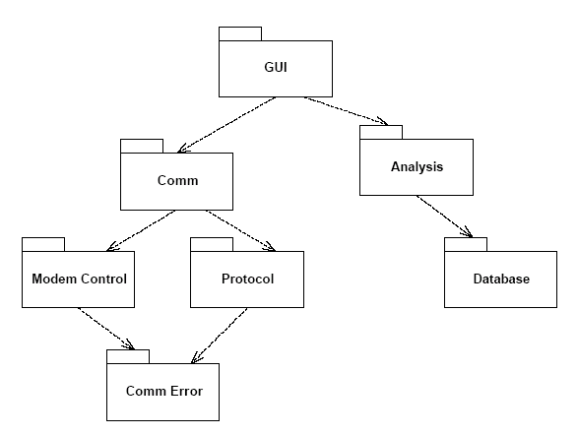
Package Diagram without Cycles
What would be required to release the Protocol package?
  The engineers would have to build it with the latest release of the CommError package, and run their tests.

Slide 10
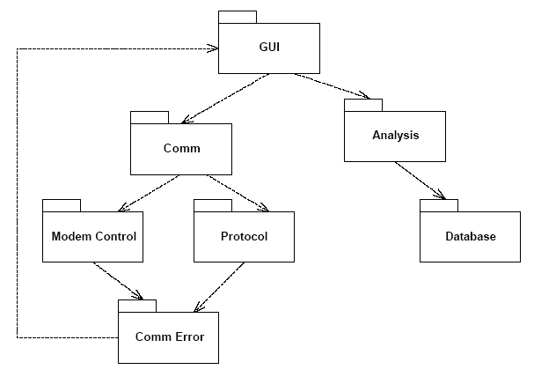
Package Diagram with Cycles
What would be required to release the Protocol package?
  The engineers would have build their test suite with CommError, GUI, Comm, ModemControl, Analysis, and Database packages!!!

Slide 11
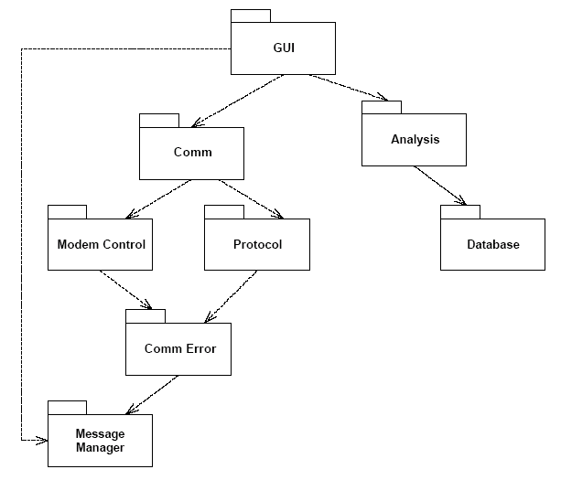
Breaking a Cycle: 1st Way
The classes that CommError needed are pulled out of GUI and placed in a new package named MessageManager. Both GUI and CommError are made to depend upon this new package.

Slide 12
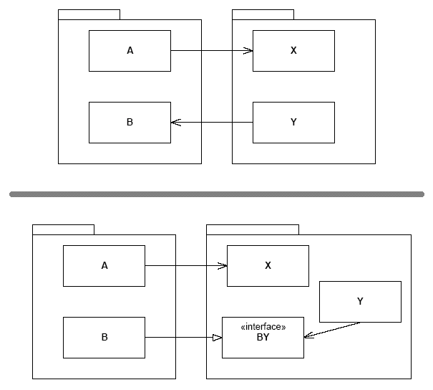
Breaking a Cycle: 2nd Way
Here we see two packages that are bound by a cycle.
Class A depends upon class X, and class Y depends upon class B.
We break the cycle by inverting the dependency between Y and B.
This is done by adding a new interface, BY, to B. This interface has all the methods that Y needs. Y uses this interface and B implements it.

Slide 13
The Stable Dependencies Principle
Depend in the direction of stability.

Slide 14
Stability
Stability, in this context, has nothing directly to do with frequency of change.
Here, stability is related to the amount of work required to make a change.
One way to make a software package difficult to change (stable), is to make lots of other software packages depend upon it.
  A package with lots of incoming dependencies is very stable because it requires a great deal of work to reconcile any changes with all the dependent packages.

Slide 15
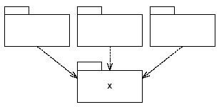
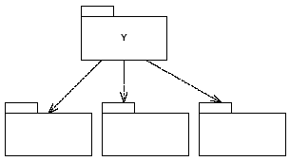
Examples
X is stable
Y is instable

Slide 16
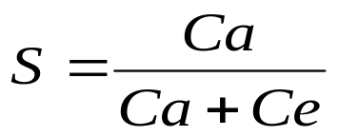
Stability Metric
Stability (S):
Afferent Coupling (Ca).
  The number of classes outside the package that depend upon classes inside the package. (i.e. incoming dependencies)
Efferent Coupling (Ce).
  The number of classes outside the package that classes inside the package depend upon. (i.e. outgoing dependencies)

Slide 17
Stability Metric (Cont’d)
This is a metric that has the range: [0,1].
  If there are no incoming dependencies, then S will be zero and the package is instable.
  If there are no outgoing dependencies then S will be one and the package is stable.
Now we can rephrase the Stable Dependencies Principle as follows: “Depend upon packages whose S metric is higher than yours.”

Slide 18
The Stable Abstractions Principle
Stable packages should be abstract packages.

Slide 19
Benefits
A stable package should also be abstract so that its stability does not prevent it from being extended.
On the other hand, an instable package should be concrete since it its instability allows the concrete code within it to be easily changed.

Slide 20
Abstractness Metric
Abstractness (A)
  The ratio of abstract classes in a package to the total number of classes in the package.
The A metric ranges from 0 to 1.
  Zero implies that the package has no abstract classes at all.
  A value of one implies that the package contains nothing but abstract classes.

